Slide 1
Git(hub) Crash Course
Basics and the GUI

Slide 2
What is Git(hub)?
Version control system
As you make changes, it keeps track of your history
If you make a mistake...just go back
Collaboration tool
Decentralized - Every user has their own repository
All local repositories usually connected to a central one (Github)
Allows easy merging of changes to a project

Slide 3
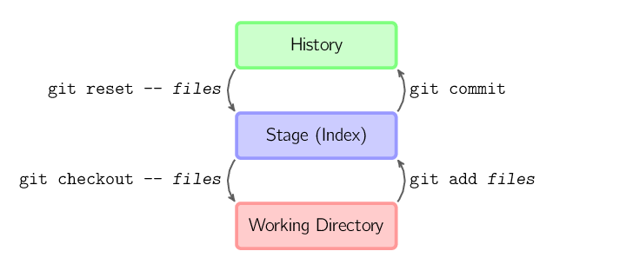
How does it work (locally)
Image from http://marklodato.github.io/visual-git-guide/index-en.html?no-svg

Slide 4
How does it work (remotely)?
Downstream
git clone - copies remote rep to local
git pull - merges remote changes to local
Upstream
git push - sends local changes to remote

Slide 5
How to collaborate - branch
git pull
make sure you are up-to-date
git branch working
create your working branch
git checkout working
make your working branch the current branch
git commit - make your changes on your working branch and commit them

Slide 6
How to collaborate - merge
git checkout master
change back to master (i.e., where you have not worked)
git pull
make sure that your local master is the same as the remote master
git merge working
merge the changes from working into master

Slide 7
How to collaborate - push
git push
push your changes from your local master back to the remote master
git branch -d working
delete your working branch

